Slide 1
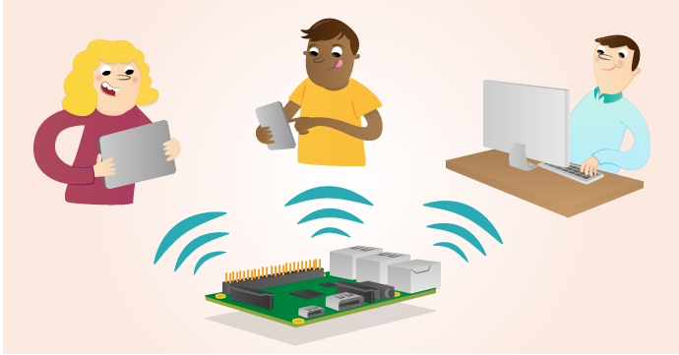
Web server-client framework on Raspberry Pi (In Python)

Slide 2
Flask
Not only can you use the Raspberry Pi to get data from servers via the internet, but your Pi can also act as a server itself.
Traditional servers like Apache are heavyweight, Flaskpi is lightweight framework to support web applications on Rpi.
Flask is a "microframework" for writing web applications in Python.
Making Rpi as a web server you can send HTML files and images to make web pages, trigger physical events, store data, or check the value of a sensor remotely via a web browser.
FlaskPi supports the extended programming language i.e. Python to create a web server that dynamically generates the HTML pages when they receive HTTP requests from a web browser.

Slide 3
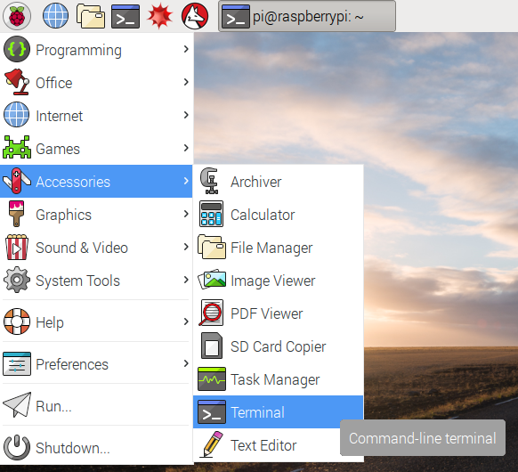
Installing Flask
Open a Terminal window from the taskbar
Install Flask by typing:
sudo apt-get install python3-flask

Slide 4
Running a web server using Flask
Create a new File on Python 3 (IDLE)
Save your file as app.py.
Type your code. Any printed messages or errors will be shown in the Python shell window
Press F5 to run the script.

Slide 5
Routing
Web applications are accessed via URLs
With the routing mechanism the user can directly go to the desired page without having to hit the home page (also known as index page).
For any web based applications, the route() method is used to bind a function to a URL.
Every route path with route(‘/specificPath’) will have a routing function linked to it which will be executed when the user routes to that specified path on the web browser.

Slide 6
Program code: To start a Raspberry Pi flask server and access the default route path (homepage)
from flask import Flask # to import the flask library
myapp = Flask(__name__) # create a flask object and give it a name such as myapp here
@myapp.route('/')
# myapp.route(‘/’) implies the default route path http://0.0.0.0:5000/
def index(): # routing function index() attached to the route path (‘/’).
# Execute the index function on accessing the address http://0.0.0.0:5000/ # Index function will return a display message of AUS on home page.
return ‘AUS’ #Send the text ‘AUS’ to the client's web browser and display it
if __name__ == '__main__': #If this script was run directly
#from the command line
myapp.run(debug=True, host=‘0.0.0.0')
# Have the server listen on default port 5000
# and report any errors. the host address =‘0.0.0.0’will enable all devices
# in the same network to access the Raspberry Pi web server.

Slide 7
Some Common examples of Routing:
@app.route('/')
def index():
return ‘Welcome to AUS’ # default route ‘/’ binds index function to it
# this will set the default route and show “AUS” on the #screen when the use navigates to http://0.0.0.0:5000/ on web browser
@app.route('/COE 410') Route Path (‘/COE410’)
def embeddedSystems(): Routing function for route path (‘COE410’) is embeddedSystems()
# route ‘/ COE 410’ binds embeddedSystems(): function to it
return ‘Embedded Systems‘ # This will set the specific route ‘/COE410’ and show “ Embedded Systems” on the screen when the user goes to the path http://0.0.0.0:5000/COE410
Route path (‘/’)
Routing function for route path (‘/’) is index()

Slide 8
Dynamic URLs
To add variable/dynamic parts to a URL you can mark these special sections as <variable_name>. Such a part is then passed as a keyword argument to your function.
For Example:
@app.route('/user/<username>')
def show_user_profile(username): # show the user profile for that user
return 'User %s' % username # displays the username on the browser # page as provided in the URL

Slide 9
HTTP Methods
HTTP (Hyper Text Transfer Protocol for web applications) has different methods for accessing URLs. By default, a route only answers to GET requests, but that can be changed by providing the methods argument to the route(). EXAMPLE:
from flask import request #import request library for HTTP methods
@app.route('/login', methods=['GET', 'POST']) # Inside the route method provide a route method to specify what you want your browser to . The HTTP method (also often called “the verb”) tells the server what the client wants to do with the requested page.(Functions of GET and POST are discussed on the next slide)
def login():
if request.method == 'POST': # check the status of the method
do_the_login() # This will POST the information provided to the web browser on the Server, can be used for a Submit or OK purpose.
else:
show_the_login_form() # This will tell the web browser to call the web server (on Raspberry pi) and GET and display the login form on the browser

Slide 10
HTTP Methods
HTTP Method | Description
GET | The browser tells the server to just get the information stored on that page and send it. This is probably the most common method. In other words, GET returns the requested item.
POST | The browser tells the server that it wants to post some new information to that URL and that the server must ensure the data is stored only once. In other words, it supplies input to servers and return the result. HTML forms usually transmit data to the server using this method.
PUT | Used to store an item on the server
DELETE | Remove the information at the given location
OPTIONS | Provides a quick way for a client to figure out which methods are supported by this URL.

Slide 11
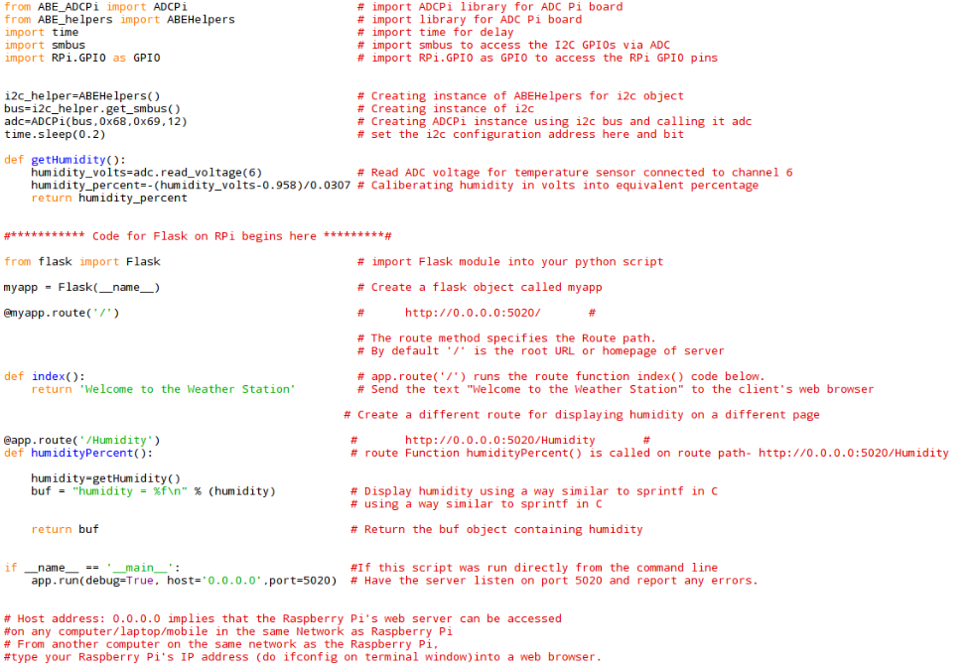
Example: Write a program to start a web server on your raspberry pi at port 5020 and display humidity on web browser
Code for ATD
Code for Flask

Slide 12
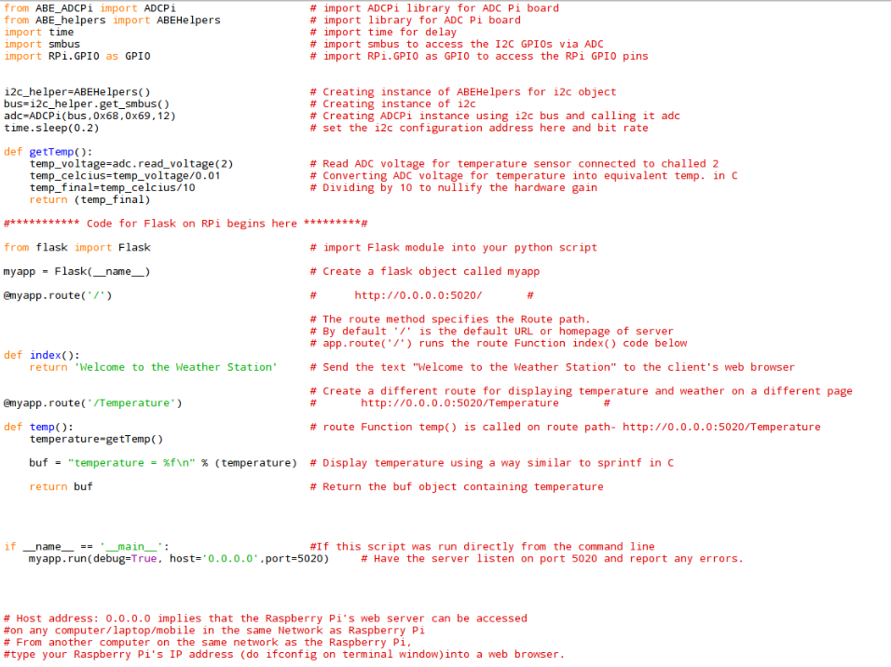
Example: Write a program to start a Flask web server on your raspberry pi at port 5020 and display temperature on web browser
Code for ATD
Code for Flask

Slide 13
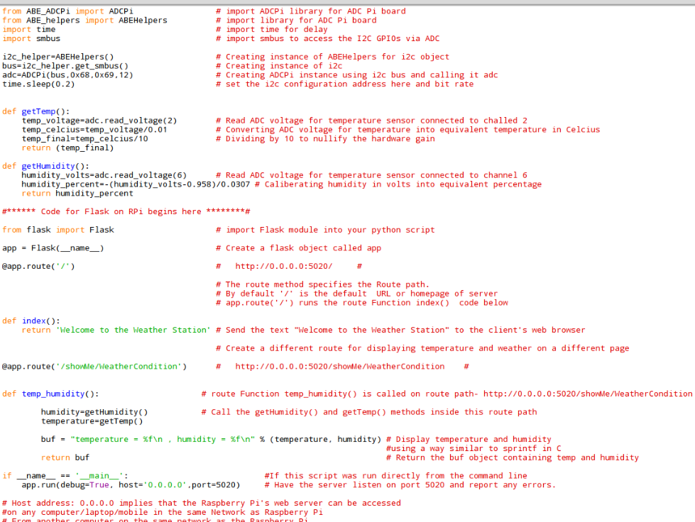
Example: Write a program to start a web server on your raspberry pi at port 5020 and display temperature and humidity on web browser
Code for ATD
Code for Flask

Slide 14
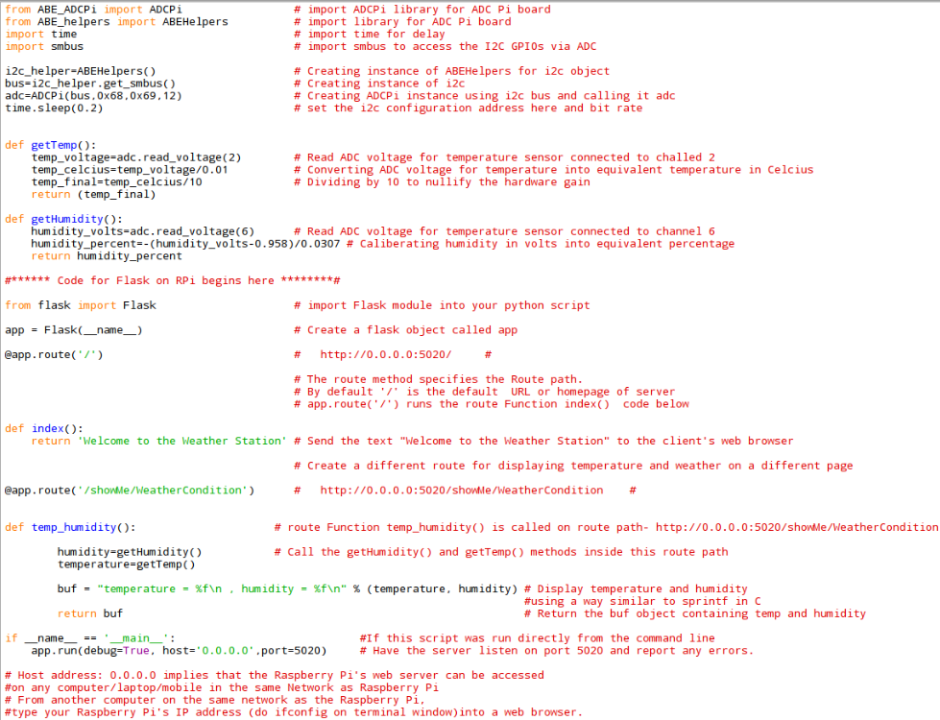
Code Breakdown: ATD part to read analog values from temperature and humidity sensor

Slide 15
Code Breakdown: Starting the Flask server on RPi and sending analog values from temperature and humidity sensor to the web browser (Use port 5020)

Slide 16
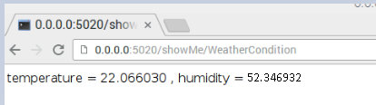
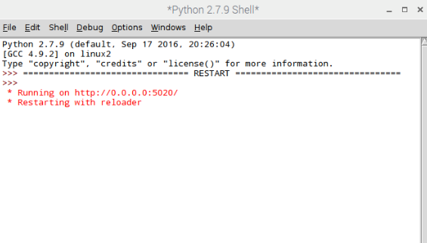
Output Display on the web browser
Access the page on your web browser by giving the default host IP address (0.0.0.0) and port number. It should be of the format : 0.0.0.0:#Port number/routePath.
Note that the default port for Flask is 5000 unless specified otherwise in the code.
OUTPUT:
Route Path on the web browser, listening at port 5020
Python shell will notify stating the
server is up and running on IP address 0.0.0.0
and Port number 5020

Slide 17
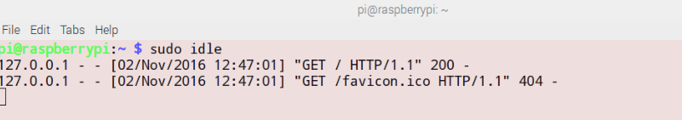
The HTTP status code “200” means that a successful GET request has been made
After the server is up and running, a few lines will appear on the terminal window as shown above. It displays that the web browser requested the root URL and the Flask server on RPi returned HTTP status code 200 for "OK.“
Notice, that the request made by the browser is a GET request by default. To explore any other type of HTTP method, need to explicitly set the method parameter in route() function.

Slide 18

Accessing RPi’s server from another device
In order to access the web server from a different device on the same network, access it using the Raspberry Pi’s IP address. RPi’s IP address can be found using the ifconfig command on terminal window. Put the RPi’s IP address with the port number on the address bar of the browser and it should display the homepage as configured on Raspberry pi.
A screenshot of accessing the Raspberry Pi’s server from a different computer is shown below:
Similarly you can access the server from a browser on a mobile. Screeshot on next slide.
Raspberry Pi’s IP address :#port number

Slide 19
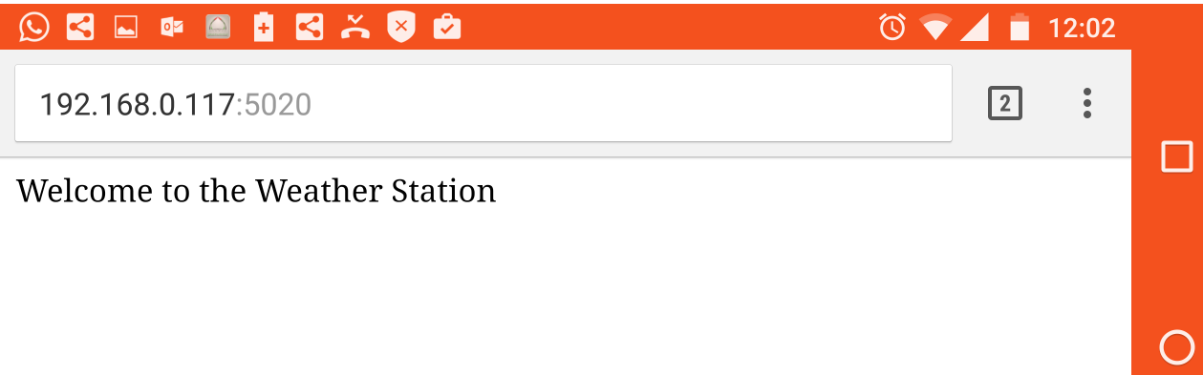
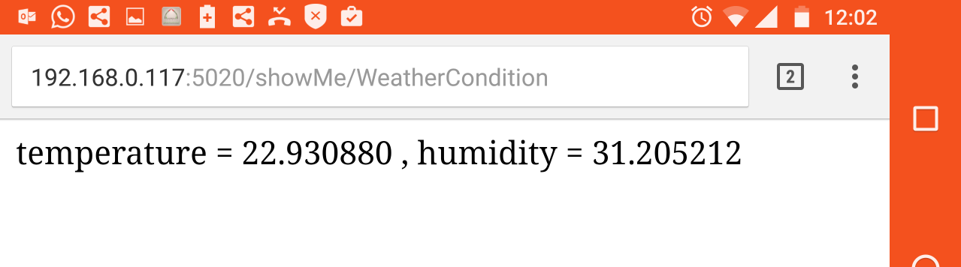
Accessing RPi’s server from mobile phone
Accessing the Default route path:
Rpi’s IP address : Port Number
Accessing the specific route path of /showMe/WeatherCondition:
Rpi’s IP address : Port Number/showMe/WeatherCondition

Slide 20
References
http://mattrichardson.com/Raspberry-Pi-Flask/
http://flask.pocoo.org/docs/0.11/quickstart/#routing
https://www.raspberrypi.org/learning/python-web-server-with-flask/
https://learn.adafruit.com/raspipe-a-raspberry-pi-pipeline-viewer-part-2/miniature-web-applications-in-python-with-flask

